Slide 1
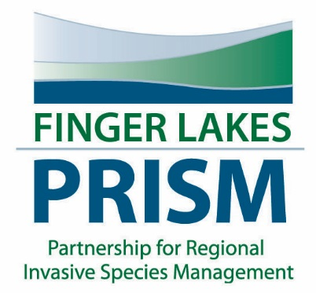
FL-PRISM Spring Partner Meeting 2015
Hilary Mosher
FL-PRISM Coordinator
Finger Lakes Institute
Hobart and William Smith Colleges
mosher@hws.edu
315-781-4385

Slide 2
Summer Student Research
Two students to work with the Finger Lakes Institute on aquatic invasive species.
Data manager for watercraft steward program
Student to conduct invasive species surveys on various waterways
State Parks FORCES
Two students will be hired to work at Seneca Lake State Park to conduct survey work and utilize iMapInvasives

Slide 3
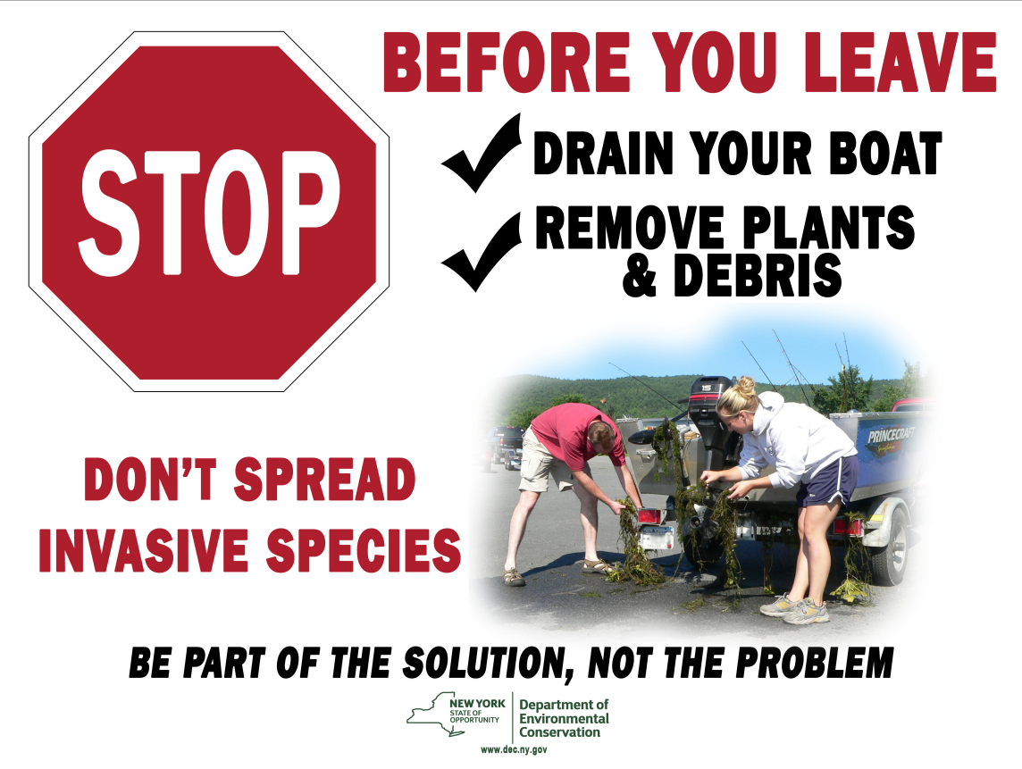
Finger Lakes Institute Watercraft Steward Program
Watercraft steward positions will come on-line once the GLRI funding has been released
Working with Finger Lakes watershed groups to leverage resources and expertise

Slide 4
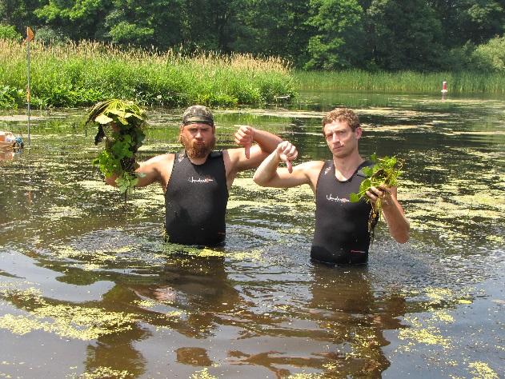
Recruit and Train Volunteers
iMap Invasives training in Ithaca
State Parks training on June 1st, Ithaca, NY
More trainings available for group of 10 or more
Invasive species survey trainings already scheduled for summer
3820 iMapinvasive observations reported last year!

Slide 5
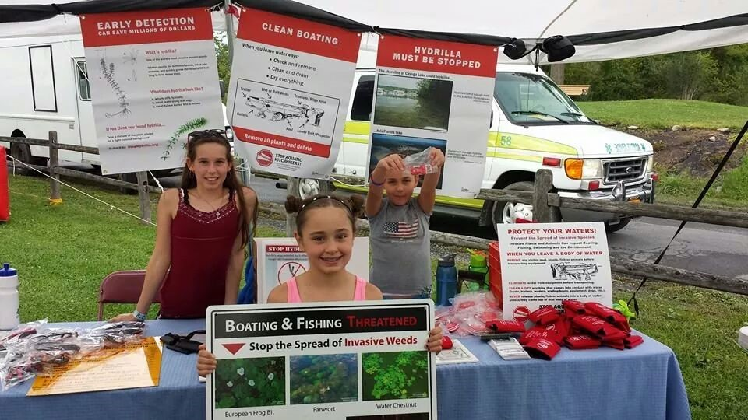
Education and Outreach
Many education and outreach opportunities throughout Finger Lakes region
Presentations at various different groups
Part-time student will be hired to supplement education and outreach to the 17-counties
Over 25 different venues targeted last year

Slide 6
Nine Subcontract Awards
1 | Keuka Outlet Trail Restoration Project | William Brown | Keuka College
2 | Doubling Down on Hydrilla and Hemlock Woolly Adelgid in the Cayuga Lake Watershed | Hilary Lambert | Cayuga Lake Watershed Network
3 | Montezuma Audubon Center- MARSH! Project Coordinator | Chris Lajewski | Montezuma Audubon Center
4 | Slowing the Spread; Mitigate, Monitor, and Manage EAB in Dewitt, NY | Chris Manchester | Town of Dewitt
5 | CCE-Broome- 4-H Invasive Forest Pest Citizen Scientists | Kevin J. Mathers | CCE Broome County
6 | Managing Invasive Plants to Facilitate Forest Regeneration at Island Cottage Woods Preserve | Kevin Farrell | Genesee Land Trust
7 | Cayuga Lake Watershed Hydrilla Project: Hydrilla and Plant Community Monitoring and Sampling for New Infestations | James Balyszak | Hydrilla Task Force
8 | Suburban Landscape as a Source of Invasive Species on the Prohibited and Regulated Species NYS DEC List (Part 575) | Kathryn Amatangelo | The College at Brockport
9 | Onondaga Injection- Selective Preservation of Ash Trees Through Trunk Injection in Response to EAB in Onondaga County | Eva Sztechmiler | Onondaga Soil and Water Conservation District

Slide 7
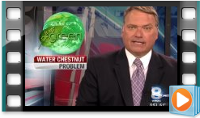
Communication
Find us on social media- Twitter and Facebook with up to date information about regional issues
Newly developed website
Listserve had an increase of 27% over last year
Media outlets target invasive species issues in the area

Slide 8
Marketing
Contracted with Wildlife Forever for two signs (5 months total)
Funding provided by NYS Bass Nation, Wildlife Forever, FL-PRISM
LOCATION #1: Route 21 just north of 488 (traffic heading S)
LOCATION #2: Route 414, 7 mi north of 90 (traffic heading S)

Slide 9
Bootbrush Station Pilot Project
Looking for partners to pilot this project in the region!

Slide 10
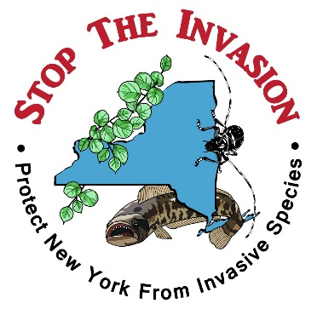
Conclusion
Exciting year ahead!
Strategic Plan
NYS AIS Management Plan
NYS AIS Coordinator
Potential for a NYS Education and Outreach Coordinator
Increase networks, increase capacity, increase communication across the FL-PRISM
Increase survey capacity and iMapInvasives use
NYS Invasive Species Awareness Week- July 12-18th
Looking for programs!

